Slide 1
FAA DataViz Challenge After-Action Review (AAR)
September 21, 2021
Christopher Burch, MBA, CPPS
Consultant

Slide 2
What is an After Action Review (AAR)?
A tool to capture lessons learned
A dynamic, professional, and candid discussion of an event
NOT a critique or complaint setting or a full-scale evaluation report
Answers 4 major questions:
1. What was supposed to happen?
2. What actually occurred?
3. What went well, and why?
4. What can be improved, and how?

Slide 3
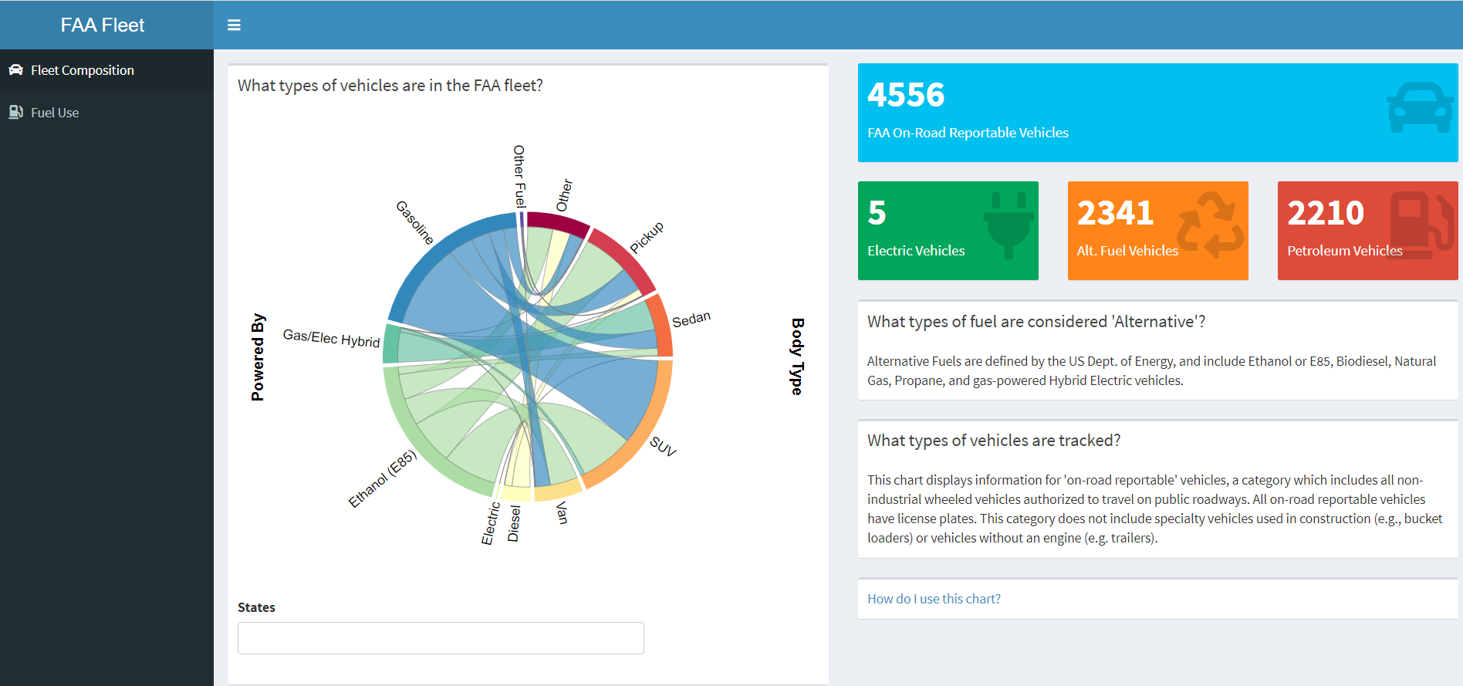
https://cburch.shinyapp.io/Data-Viz-Challenge

Slide 4
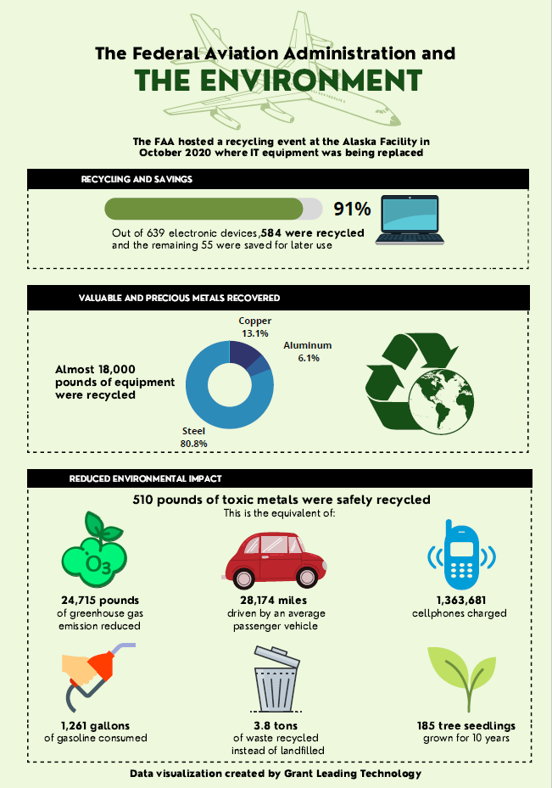

Slide 5
What did we intend to do?
Challenge Objectives (FAA)
Develop a visualization that leverages data from the Administrator’s Fact Book and other related data sets.
Explore the EIM Platform, which provides access to a repository of FAA data and a suite of cloud-based tools dedicate to enabling users to Discover, Access, Explore & Transform, Analyze & Model, and Visualize data.

Slide 6
What did we intend to do? (cont.)
Additional Objectives (GLT)
Show GLT expertise and capabilities
Develop internal practices
?

Slide 7
What actually occurred? Did we accomplish our goals?
Products Produced:
Interactive dashboard
Shiny/javascript
Independent of vendor (MS, etc)
Static graphic
Combination of techniques used

Slide 8
What actually occurred?

Slide 9
What went well, and why?

Slide 10
What could be improved, and how?
Admin considerations – regulations, paperwork, etc.
Rushed / last minute
Almost missed admin deadlines for CO notification
Improvements
Can improve with advance planning
Currently implementing advanced planning with the latest competition (Bot Challenge)

Slide 11
What could be improved, and how?
Design / Participation – more voices / perspectives, especially for creative or new ideas
Data Viz team was relatively small
Relatively few meetings
Not a lot of delegation
Improvements
Larger / more diverse team
Reach across GLT to find subject matter experts
Involve GLT team to create subject matter experts

Slide 12
What could be improved, and how?

Slide 13
Conclusions
Participation in this challenge was beneficial to GLT, even if we don’t win
We need to apply a project management approach to any future challenges of this nature
We need to identify and encourage individual areas of expertise and interest (graphic design, coding, pitching, etc.)
?

Slide 14
Questions / Comments

